Slide 1
Reverse Data Hiding Through Histogram Shifting For Security System Using Error Correction
Project Guide:
Ms.Baby.D.Dayana M.E, A.P(O.G)
Batch Number:
D10
Batch Mates:
V.S.P.P.K Prithvi (RA1411003020190)
Akhil Mantha (RA1411003020228)
M.Manideep (RA1411003020242)
Karan Khosla (RA1411003020222)
SRM INSTITUTE OF SCIENCE AND TECHNOLOGY-CSE
1/24

Slide 2
Abstract:
An enhancement of data protection system for secret communication using histogram shifting technique and multiple node communicating is done using a binary tree . The Selective embedding is utilized in this method to determine host signal samples suitable for data hiding.
Gray Scale variation is prefered over a complete image so that there is no loss in bits while transmission. Gray scale is an object or an entity of an image. Here a complete image is consiederd rather than a gray scale entity as the image is sharp and descriptors can be used and histogram shifting technique is used to compare the embedded and the original image. The color image is converted to a gray image as the it reduces the computation cost.
SRM INSTITUTE OF SCIENCE AND TECHNOLOGY-CSE
2/24

Slide 3
Existing Methods:
Direct bit replacement Process
Reverse data hiding using RC7 algorithm
Drawbacks:
Embedding Robustness is less
Edge information loss due to ringing artifact.
Low hiding capacity & low security
SRM INSTITUTE OF SCIENCE AND TECHNOLOGY-CSE
3/24

Slide 4
Proposed Method:
The Image Steganography technique is based on histograsm shifting technique,
To overcome noise in the media by proposing a difference expansion algorithm
Histogram shifting technique with peak and zero points is used.
Audio hiding process
Finding the difference between the significant pixel pair or the vectors which can also improve the efficiency and the compressibility of the location map.
SRM INSTITUTE OF SCIENCE AND TECHNOLOGY-CSE
4/24

Slide 5
Advantages:
High hiding Capacity & High Robustness
Less degradation in Image quality during hiding
SRM INSTITUTE OF SCIENCE AND TECHNOLOGY-CSE
5/24

Slide 6
Modules
Original Image
MPE2 Algorithm
Pixel And Color Coherence Vector
RGB Images
Data Embedding
Applied Histogram Shifting Technique
SRM INSTITUTE OF SCIENCE AND TECHNOLOGY-CSE
6/24

Slide 7
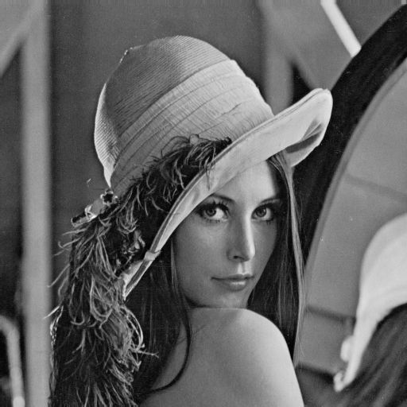
Original Image
The text to be embedded here is used on an image.
Steganography can be applied on any medium. The cover medium here is an image.
The original image is what we need at the end of the extraction message.
SRM INSTITUTE OF SCIENCE AND TECHNOLOGY-CSE
7/24

Slide 8
Histogram Shifting Technique
The histogram shifting based reversible data hiding schemes embed the data by shifting histogram in a particular direction.
The peak point corresponds to the most number of pixels in the image.
And the zero point the number in histogram is zero.
The hiding capacity of the shifting based data hiding equals the number of pixels in the peak point.
The larger the pixels in the peak point, higher the capacity of hiding.
SRM INSTITUTE OF SCIENCE AND TECHNOLOGY-CSE
8/24

Slide 9
1 Bin/2 Bin MPE2 Algorithm
This is a RDH algorithm that is based on the idea of employing two predictors to compute the predictions in order to take advantage of the different capabilities of different predictors.
This is expected to increase the prediction accuracy, hence, increasing the embedding capacity.
Additionally, and unlike the MPE algorithm, the proposed algorithm uses one bin of the prediction errors histogram for embedding the data.
SRM INSTITUTE OF SCIENCE AND TECHNOLOGY-CSE
9/24

Slide 10
Pixels & Color Coherence Vectors (ccv) Pseudo Steps
Blur the image slightly by replacing the pixel values.
Eliminates small variations between neighboring pixels.
Discretize the color-space such that only n distinct colors.
Classify the pixels in the given color bucket.
Check the given value τ which is a constant. If the pixel value is less than tau then the given pixel is incoherent.
SRM INSTITUTE OF SCIENCE AND TECHNOLOGY-CSE
10/24

Slide 11
RGB Images
An RGB image, sometimes referred to as a "truecolor" image, is stored in MATLAB as an m-by-n-by-3 data array that defines red, green, and blue color components for each individual pixel.
RGB images do not use a palette. The color of each pixel is determined by the combination of the red, green, and blue intensities stored in each color plane at the pixel's location.
Graphics file formats store RGB images as 24-bit images, where the red, green, and blue components are 8 bits each.
This yields a potential of 16 million colors. The precision with which a real-life image can be replicated has led to the commonly used term "truecolor image."
SRM INSTITUTE OF SCIENCE AND TECHNOLOGY-CSE
11/24

Slide 12
Data Embedding
Data hiding is a process to conceal secret message bits into another medium like image, audio or video files.
Here, the hiding is performed under compressed bit stream of cover image. After obtaining of bit streams, it is allowed to encrypt with random binary string using bitxor operation.
Before data hiding, the text message will be encrypted using chaos encryption to make second level security during transmission.
Bits wrap method is used here to conceal secret text bits under encrypted compressed bit streams. It is performed using logical bitwise operations like ‘bitand’ and ‘bitor’ operations.
After hidden the data, image reconstruction and data extraction will be performed to measure the system performance.
SRM INSTITUTE OF SCIENCE AND TECHNOLOGY-CSE
12/24

Slide 13
RC7 Encryption Algorithm
To improve the encryption efficiency of the already existing RC6 algorithm [20], RC7 has been proposed which takes relatively less time to encrypt data and is comparatively more flexible.
Instead of four working registers, RC7 makes use of six such registers which makes it a better alternative to RC6.
SRM INSTITUTE OF SCIENCE AND TECHNOLOGY-CSE
13/24

Slide 14
Architecture Pattern
The process is divided into two
1) Embedding Process
2) Extraction Process
SRM INSTITUTE OF SCIENCE AND TECHNOLOGY-CSE
14/24

Slide 15
Block Diagram: Embedding Process:
Embedding Process:
Input Image
Pixel/Vector difference & Select Channel
Pixels/Vectors
Secret Data
RC7
Encryption
Data Embedding
Stego Image
Audio Input
Image Embedding
1 Bin MPE2
Algorithm
Audio output
SRM INSTITUTE OF SCIENCE AND TECHNOLOGY-CSE
15/24

Slide 16
Extraction Process:
Audio output
Stego Image Extraction
Plane Separation & Select Channel
Extraction process
Recover Image
RC7 Decryption
Audio Extraction
1 Bin MPE2 Extracction Process
Original Data
SRM INSTITUTE OF SCIENCE AND TECHNOLOGY-CSE
16/24

Slide 17
Application:
Research institutes.
Medical information protection.
Defense application.
Digital Libraries(annotations)
SRM INSTITUTE OF SCIENCE AND TECHNOLOGY-CSE
17/24

Slide 18
Algorithm/Implementation
REQUIREMENTS:
1.MATLAB Open Source Software
2.Image and MATLAB code in the same folder
3.Image should be .jpg ,.png formats
STEPS FOR IMPLEMENTATION:
1.Open Matlab software and paste the embedding code.
2.Put the name of image which is being used in ‘imread’ function in the code.
3.Run the code to get the following output files:
•Embedding Histogram
•Image after embedding
•Difference Image after embedding
SRM INSTITUTE OF SCIENCE AND TECHNOLOGY-CSE
18/24

Slide 19
4.Now after the embedding process paste the extraction code.
5.Take the stego image(image after embedding) and put in ‘imread’ function in the code.
6.Run the code to get the following output files:
•Extraction Histogram
•Image after extraction
SRM INSTITUTE OF SCIENCE AND TECHNOLOGY-CSE
19/24

Slide 20
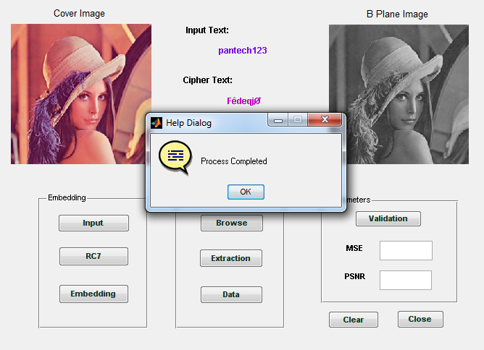
RC7 Encryption
SRM INSTITUTE OF SCIENCE AND TECHNOLOGY-CSE
20/24

Slide 21
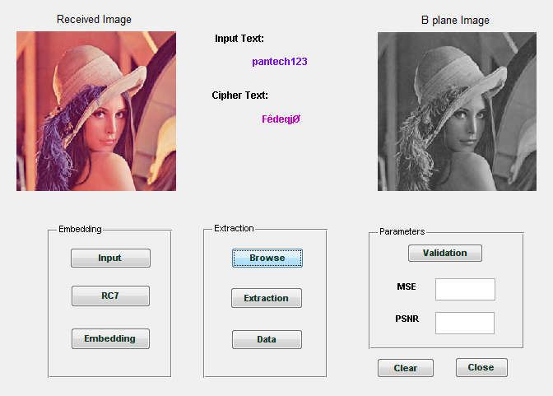
Stego Image selection
SRM INSTITUTE OF SCIENCE AND TECHNOLOGY-CSE
21/24

Slide 22
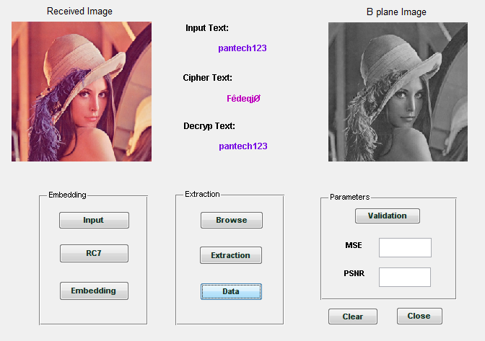
Extracted Data
SRM INSTITUTE OF SCIENCE AND TECHNOLOGY-CSE
22/24

Slide 23
Conclusion
Using a complete image instead of gray scale variation.
Using histogram shifting technique for comparing images.
Using RC7 Algorithm with an error control method.
Done research on 1 Bin MPE2 algorithm which can be used to detect the error while finding the difference between pixel frames or vector difference.
SRM INSTITUTE OF SCIENCE AND TECHNOLOGY-CSE
23/24

Slide 24
References
[1] J. Fridrich and M. Goljan, “Lossless data embedding for all image formats,” in Proc. SPIE Proc. Photonics West, Electronic Imaging, Security and Watermarking of Multimedia Contents, San Jose, CA, USA, Jan. 2002, vol. 4675, pp. 572–583.
[2] V. Sachnev, H. J. Kim, J. Nam, S. Suresh, and Y.-Q. Shi, “Reversible watermarking algorithm using sorting and prediction,” IEEE Trans. Circuits Syst. Video Technol., vol. 19, no. 7, pp. 989–999, Jul. 2009.
[3] F. M. Willems and T. Kalker. “Coding theorems for reversible embedding.” DIMACS Series in Discrete Mathematics and Theoretical Computer Science, vol. 66, pp.61-78, 2004.
SRM INSTITUTE OF SCIENCE AND TECHNOLOGY-CSE
24/24

